Slide 1
Claim report project
Claim report project is a web-based secure role-based system for collecting and processing Extenuating Circumstances (EC) claims by students in a large university

Slide 2
Member
Claim report system
Group members
Nguyen Thanh Tuan | Product owner, database, developer, tester
Pham Van Sang | Scrum master, developer, tester
Nguyen Ngoc Bao Chau | Tester
Teacher | Doan Trung Tung

Slide 3
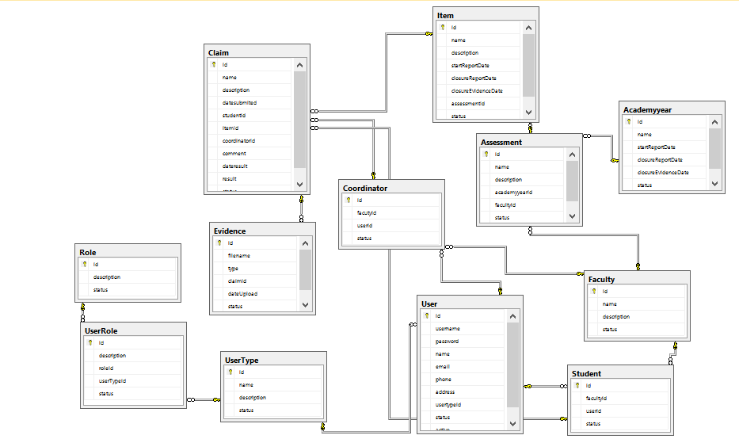
ERD

Slide 4
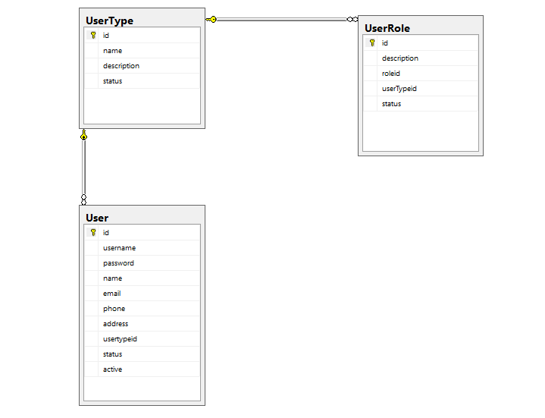
Role base system

Slide 5
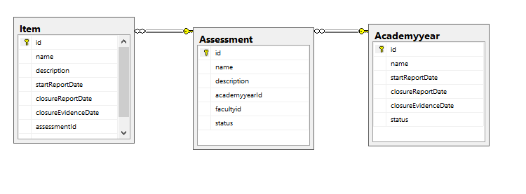
Relationship academy year – assessment - item

Slide 6
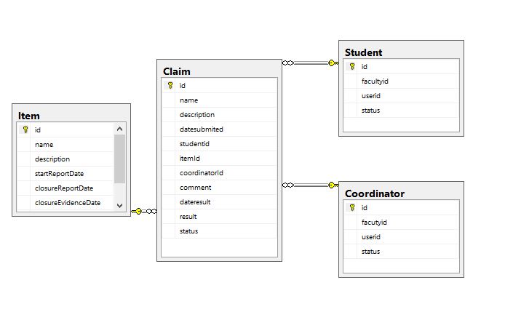
Relationship claim and related entities

Slide 7
Responsive design
All pages use bootstrap framework so that all pages are responsive
After doing a page, we also test in many screen sizes
In most cases, the layout is not break.

Slide 8
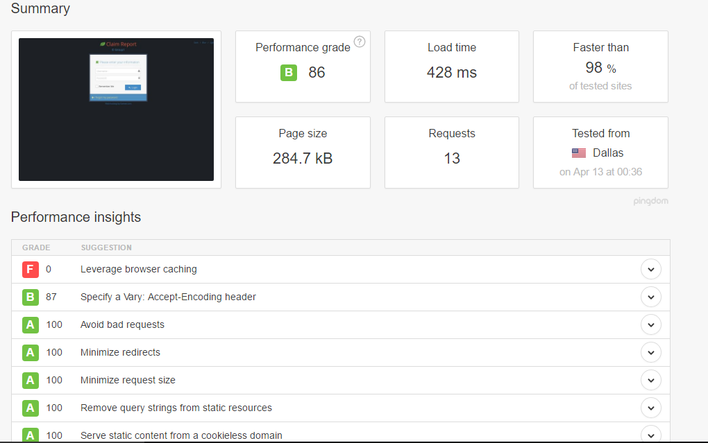
Usability
I have already tested my website in https://tools.pingdom.com

Slide 9
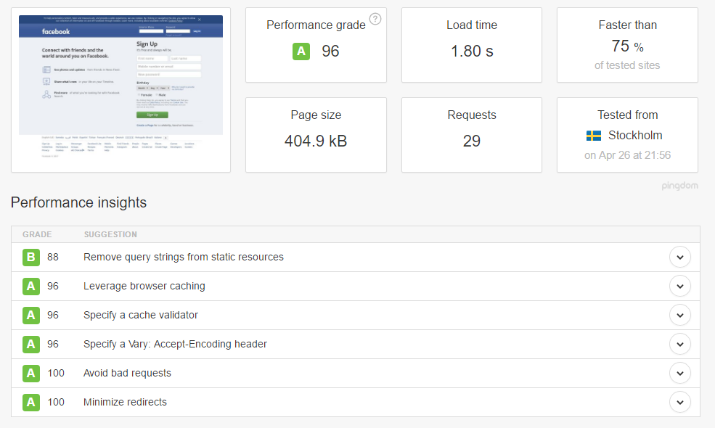
Usability
Compare to www.facebook.com

Slide 10
User story
I want to… | Responsible | Process
view all the claim | Sang | Done
view report | Sang | Done
manage process for the faculty | Sang | Done
disable all claims uploading after closure date | Tuan | Done
allow student upload evidence after closure date until final closure date | Tuan | Done
receive a notification when there is a new claim | Tuan | Done
process the claim before 14 days since the upload date. | Tuan | Done
access student claim in my faculty | Sang | Done
belong the faculty | Sang | Done
upload one or more the EC claim | Tuấn | Done
all of EC uploaded claim have to contain PDF or Image evidence. | Tuan | Done
receive the email when the claim has a result. | Tuan | Done
view my claims and its result. | Tuan | Done
change closure dates for each academic year | Sang | Done
change items of assessment and their due dates | Sang | Done
change students and passwords | Sang | Done
manage user and roles | Sang | Done
login to the system. | Tuan | Done
specific role in the system | Sang | Done
view this website in many devices such as mobile, web, | Sang | Done

Slide 11
Testing
Because of lacking time, we choose black box testing technique. We attempt to cover almost situations in extreme case.
The test case procedure after each sprint backlog done
The fail test continued to test in next time until it successes.
The test covers both functional and non-functional test
The test log can be found in group material

Slide 12
Test plan
I show some test case plans. The detail can be found in test log document in https://github.com/gwthanhtuanvp88/SEM6_WE
Test Plan
Test | What is being tested | How | Test data used | Expected results
1 | Login function | Username and password is passed into the form in order to login | - name : thanhtuan - password : 123456 | - Login ok
2 | Login function fail | Username and password is passed into the form in order to login | - name : thanhtuan - password : 1234567 | - Login fail - Message in UI to user
3 | Validate input form login | Username is passed into the form in order to login | - name : thanhtuan - pass : no input | - Message please input password
4 | Test responsive login form | Resize browser screen |  | - Layout is not break
5 | Sql injection | Username is passed into the form in order to login | - name : ' or ''=' - pass : ' or ''=' | - Login fail - Message in UI to user

Slide 13
Test log
I show some test logs. The full test log can be found in test log document in https://github.com/gwthanhtuanvp88/SEM6_WE
Test Log 1
Date | Actual results | Action taken
16/3/2017 | - Login ok | None
16/3/2017 | - Login fail - Message in UI to user | None
16/3/2017 | - Message login fail is shown | Recode and test again
16/3/2017 | - Layout is not break
16/3/2017 | - Login fail - Message in UI to user | None

Slide 14
Non-functional test
My team also tested non-functional test when our team finished each sprint backlog such as the layout of the user interface. For example :
Test responsive login form | Resize browser screen |  | - Layout is not break | 16/3/2017 | - Layout is not break | None

Slide 15
Agile methodology
Scrum is an agile process that uses for the project have the rapid change and emergent requirements. And it is suitable for small team like us. It is one of the most important reason why I choose it.

Slide 16
Product backlog
2 | manager | view all the claim
3 | manager | view report
2 | Coordinator | manage process for the faculty
3 | Coordinator | disable all claims uploading after closure date
3 | Coordinator | allow student upload evidence after closure date until final closure date
2 | Coordinator | receive a notification when there is a new claim
2 | Coordinator | process the claim before 14 days since the upload date.
3 | Coordinator | access student claim in my faculty
2 | Coordinator | belong the faculty
3 | student | upload one or more the EC claim
3 | student | all of EC uploaded claim have to contain PDF or Image evidence.
3 | student | receive the email when the claim has a result.
3 | student | view my claims and its result.
2 | administrator | change closure dates for each academic year
3 | administrator | change items of assessment and their due dates
2 | administrator | change students and passwords
2 | administrator | manage user and roles
2 | user | login to the system.
2 | user | specific role in the system
3 | user | view this website in many devices such as mobile, web,

Slide 17
Sprint 1
Backlog Item
As a manager, i want to view all the claim
As a user, i want to login to the system.
As a manager, i want to view report
As a Coordinator, i want to belong the faculty
main layout
Setup project + Git
ERD
Setup scrum board + blacklog

Slide 18
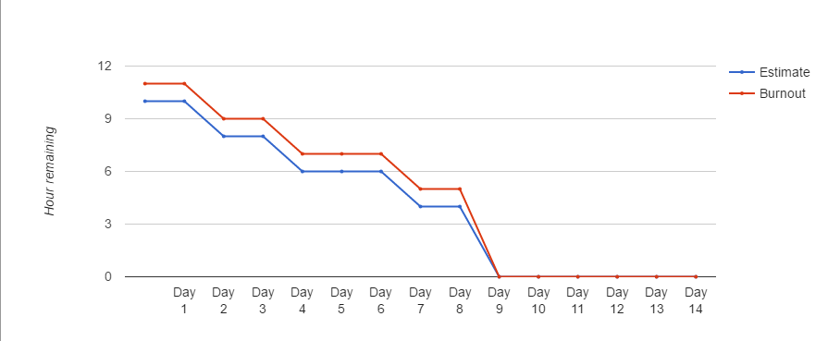
Sprint 1
Notes:
Retake photo

Slide 19
Sprint 2
Backlog Item
Fix database and the code related
Fix US: As a manager, i want to view all the claim
As a user, I want to specific role in the system
As a Admin, I want to manage user and roles
As a admin, I want to change students and passwords
As a admin, I want to change closure dates for each academic year
As a student, I want to upload one or more the EC claim
As a Coordinator, I want to receive a notification when there is a new claim
As a Coordinator,I want to process the claim before 14 days since the upload date.
As a Coordinator, I want to belong the faculty
As a Coordinator, I want to manage process for the faculty

Slide 20
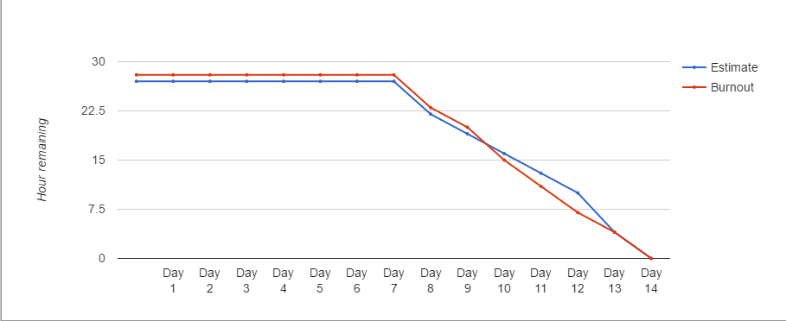
Sprint 2

Slide 21
Sprint 3
Backlog Item
As a manager, I want to view report
As a Coordinator, I want to access student claim in my faculty
As a user, I want to view this website in many devices such as mobile, web
As a student, i want all of EC uploaded claim have to contain PDF or Image evidence.
As a student, i want to view my claims and its result.
As a student, i want to receive the email when the claim has a result.
As a Coordinator, i want to allow student upload evidence after closure date until final closure date
As a Coordinator, I want to disable all claims uploading after closure date

Slide 22
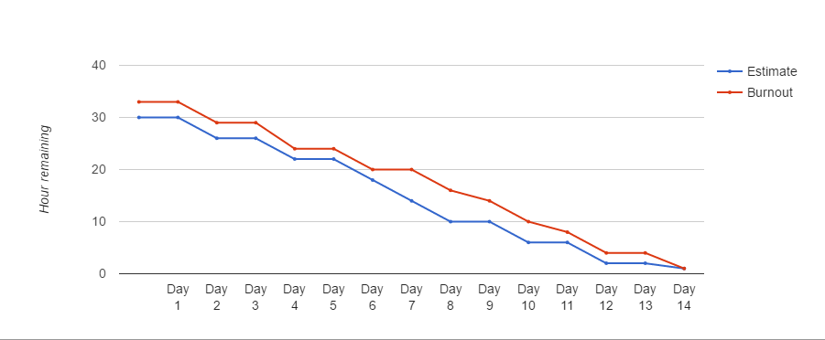
Sprint 3

Slide 23
Sprint 4
Backlog Item
Add search for Academy year Page
Add search for Users page
Add search for Assessments page
Add search for Item page
Us: As an administrator, I want to change items of assessment and their due dates
Fix: As a Coordinator, I want process the claim before 14 days since the upload date.
Fix: As a User, I want to view this website in many devices such as mobile, web,
Add search for claim page
Fix: UI for claim page
Fix: Database

Slide 24
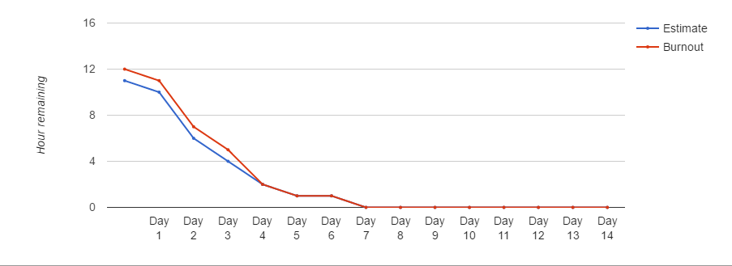
Sprint 4

Slide 25
Meeting minute summary
In most daily meetings, we are always on time and especially we finish the previous task
It is a good time to all team members solve the problem of others

Slide 26
The End

